Slide 1
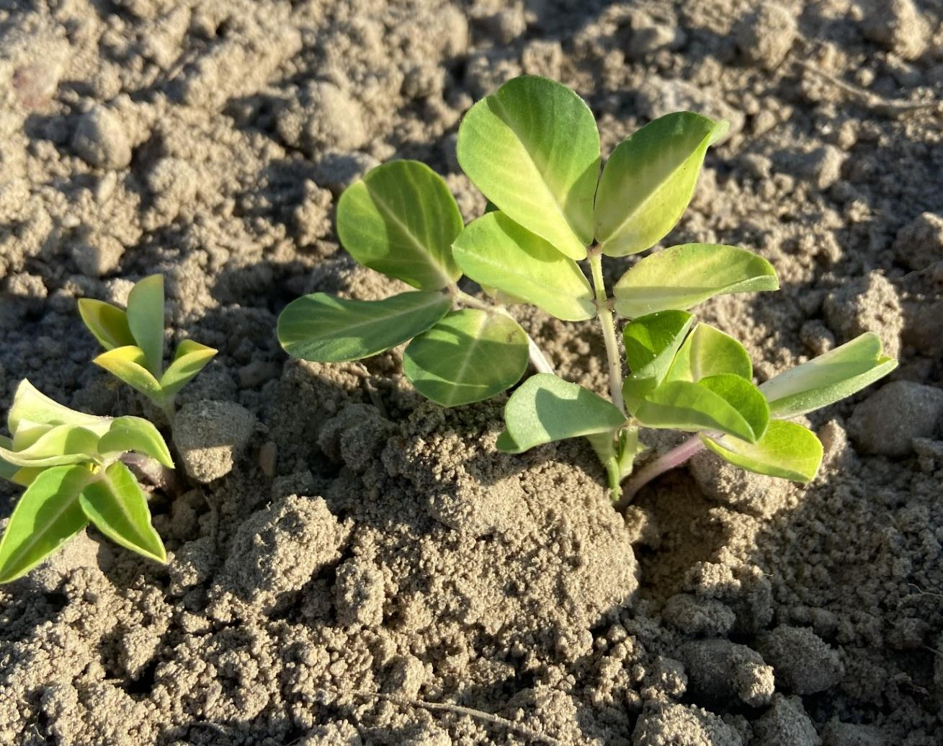

Peanut Response to Delayed Timings of Fluridone (Brake®) and Trifludimoxazin (Rexovor®)
Nicholas J. Shay & Eric P. Prostko Dept. Crop & Soil Sciences

Slide 2
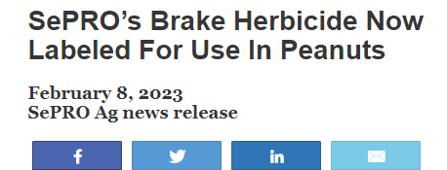

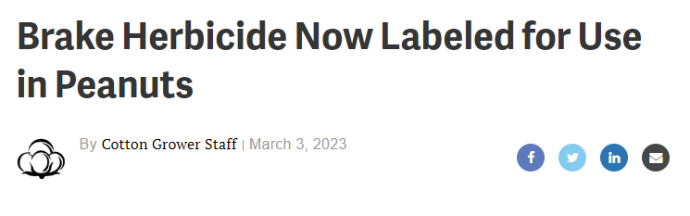
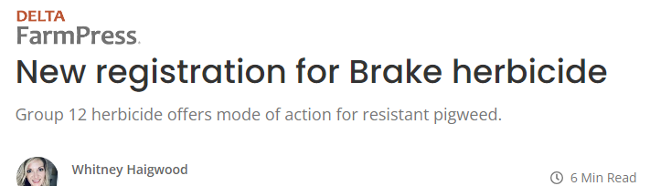

Introduction:
Brake® registration 2023
Notes:
Another MOA to help control similar problematic weeds as valor.
You may be asking why?

Slide 3
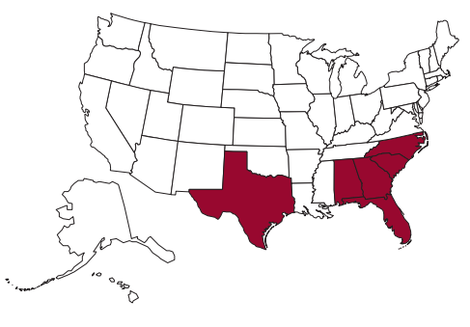
Introduction:
The case for new herbicides
Herbicide Use - Treated hectares
HERBICIDE RESISTANCE
USDA NASS – 2018 chemical use survey
Notes:
I present to you my case for a new herbicide

Slide 4
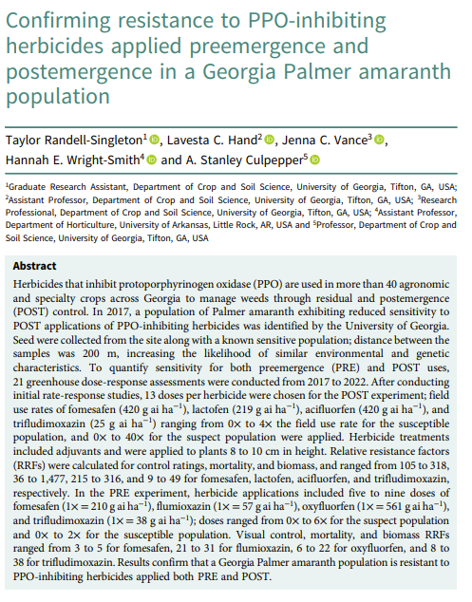
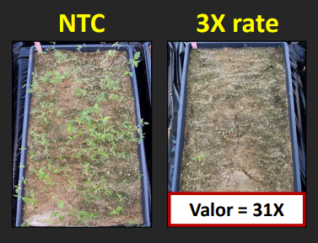
Introduction:
The case for new herbicides

Slide 5
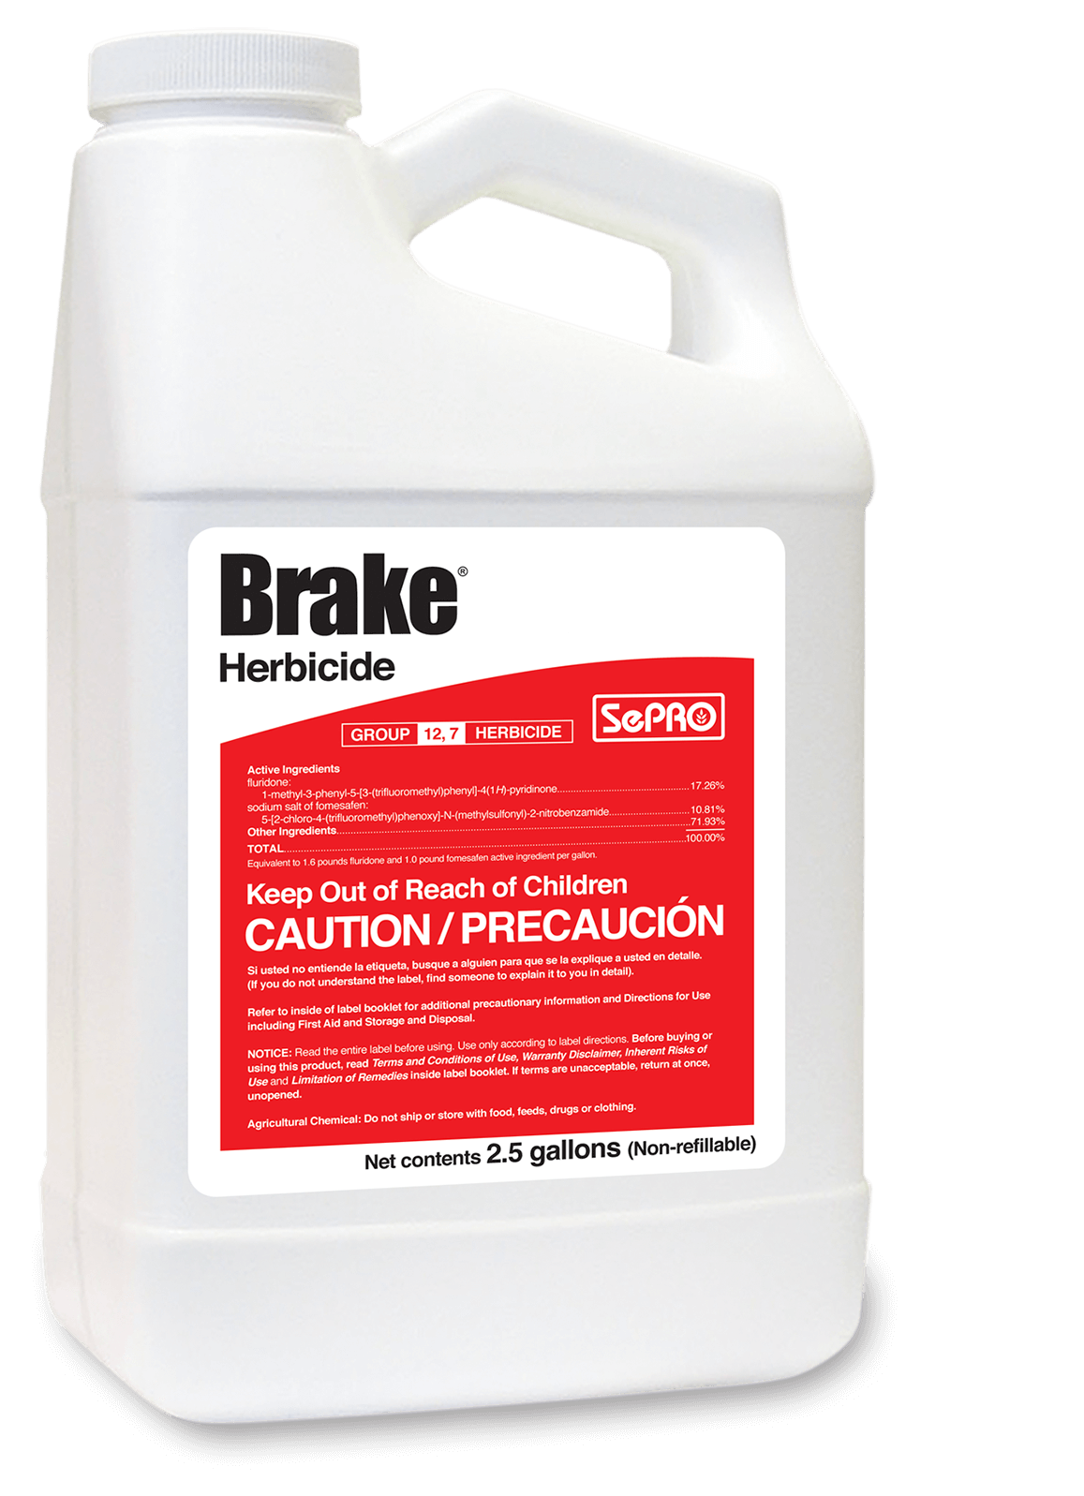
Introduction:
Brake®
Fluridone
WSSA Group # 12
  Phytoene Desaturase Inhibitor
Application method: PRE
“Apply behind the planter (i.e. at planting) or within 36 hours after planting.”
Notes:
Currently one of the concerns is the application window
Why is this a concern?

Slide 6
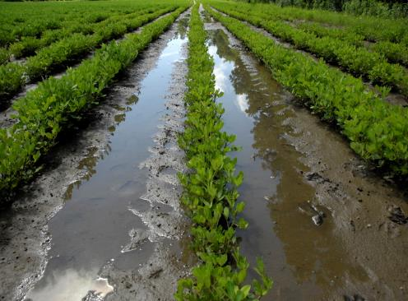
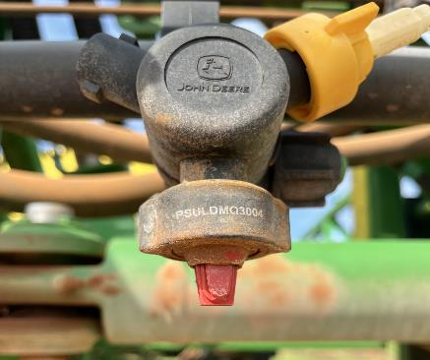

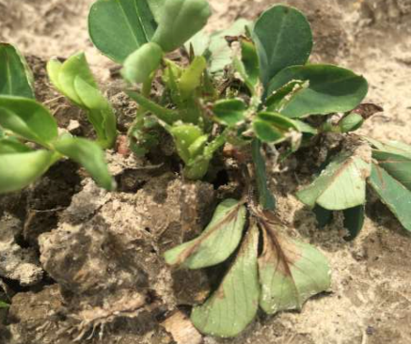
  Introduction:
  Reasons for delayed herbicide applications
Weather
Equipment failures
Operational/labor constraints
Injury
Johnson et al. 2006
Notes:
Often receive a phone call from a county agent or a grower, hey I planted but…

Slide 7
Introduction:
Rexovor®
Fluridone
WSSA Group # 12
  Phytoene Desaturase Inhibitor
Application method: PRE
“Apply behind the planter (i.e. at planting) or within 36 hours after planting.”
Trifludimoxazin
Rexovor® (BASF)
WSSA Group # 14
  Protoporphyrinogen Oxidase Inhibitor
Application method: PRE

Slide 8
Objective
Evaluate peanut response to delayed timings of fluridone and trifludimoxazin.
H_{o}: Delayed applications, regardless of timing, will have no effect on peanut density, growth, and yield.
Notes:
The more we use brake the more we understand its effectiveness and limitations within peanut production.
At what point do we tell a grower no do not apply brake and move to plan B for weed control.

Slide 9
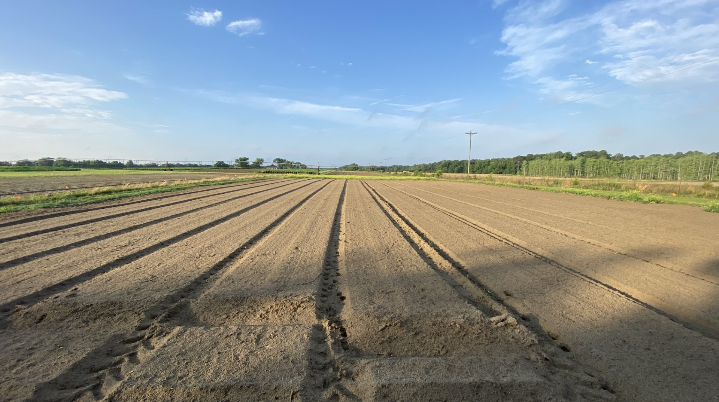

  Methods:
  Experimental Design
Experimental Period: 2022 – 2023
Location: Ponder Farm; Ty Ty, GA
  Dothan/Tifton sand
Peanut cultivar:
  GA-06G
RCB design; 4 replications
  3x4 factorial arrangement
Treatments:
  NTC
  Fluridone: 126 g ai ha⁻¹
  Trifludimoxazin: 37 g ai ha⁻¹
  Timing: 1, 3, 5, 7 DAP
Data analyzed in SAS 9.4 (Cary, NC)
  PROC GLIMMIX
  Tukey-HSD (P = 0.10)
    Pairwise comparison
Notes:
202,622 seeds / ha

Slide 10
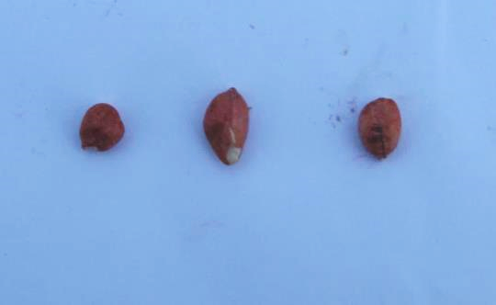
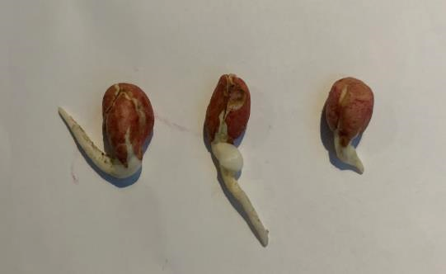
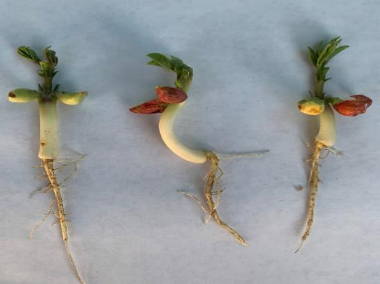
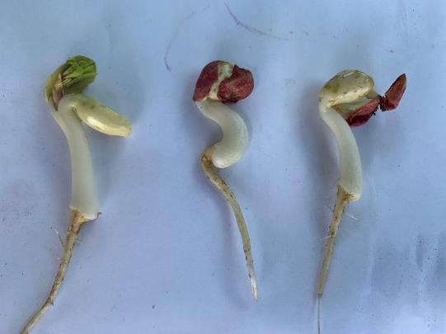
Timing - 2022
1 DAP (~20 HAP)
3 DAP
5 DAP
7 DAP*
*7 DAP: >50% GROUND CRACKING; 20-25% GREEN PLANT TISSUE EXPOSED.
Notes:
At each treatment application, we documented stages of development up and through ground cracking.

Slide 11
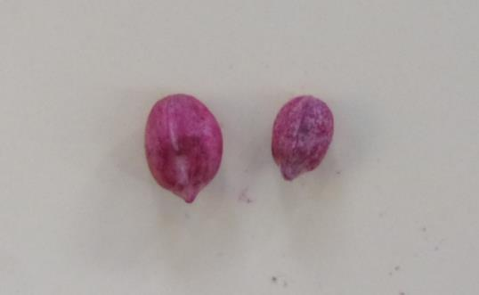
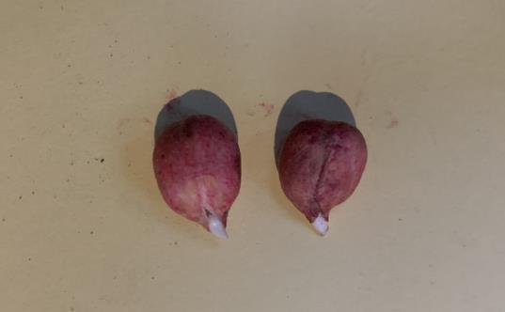
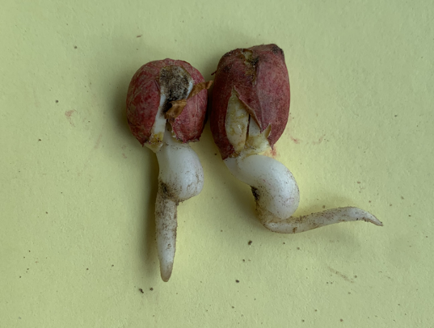
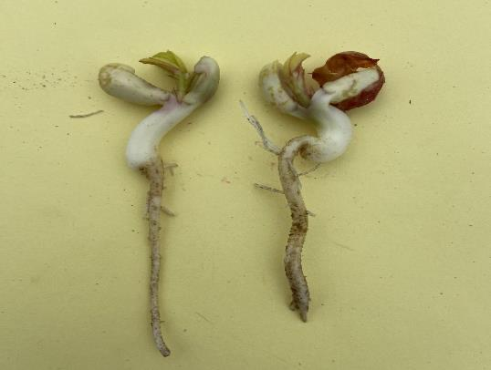
Timing - 2023
1 DAP (~20 HAP)
3 DAP
3 DAP
1 DAP (~20 HAP)
5 DAP
7 DAP*
*7 DAP: 50% GROUND CRACKING, <10% GREEN TISSUE EXPOSED.

Slide 12
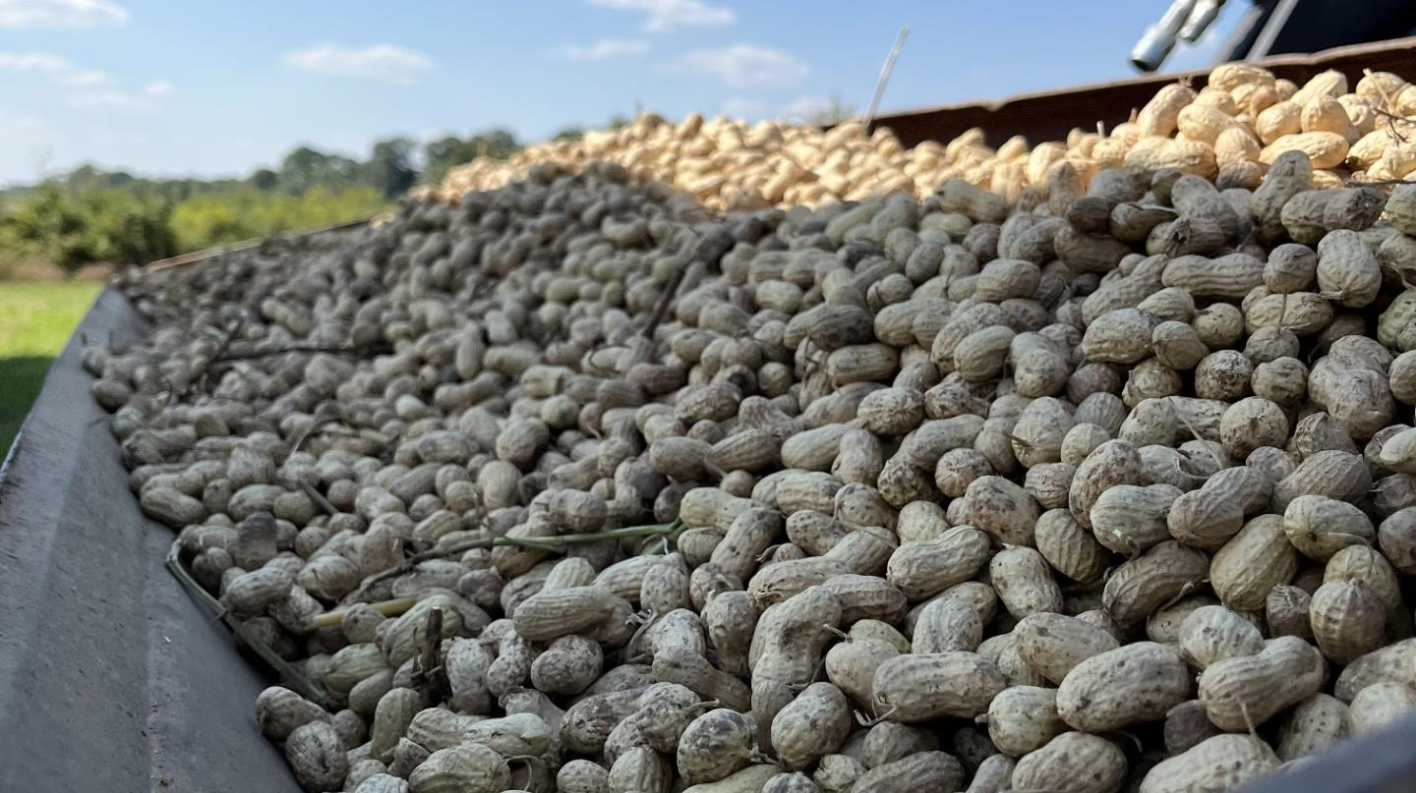
  Results
RESPONSE VARIABLES:
Density (stand)
Stunting
Herbicide symptomology
Height
Width
Yield
Notes:
COMMON RESPONSE VARIABLES WHEN EVALUATING NEW HERBICIDES

Slide 13
  Results:
  Peanut density 13 DAP following fluridone and trifludimoxazin (2022-2023)
P = 0.03
P = 0.034
6%
*Columns with letter separation are significantly different at (P < 0.1)
Notes:
3 phases…
19.7 plants (optimum threshold/recommendation) / 1.5 meters

Slide 14
  Results:
  Peanut stunting 13 DAP following fluridone and trifludimoxazin @ 1, 3, 5, 7 DAP (2022-2023)
P = 0.02
*Columns with letter separation are significantly different at (P < 0.1)

Slide 15
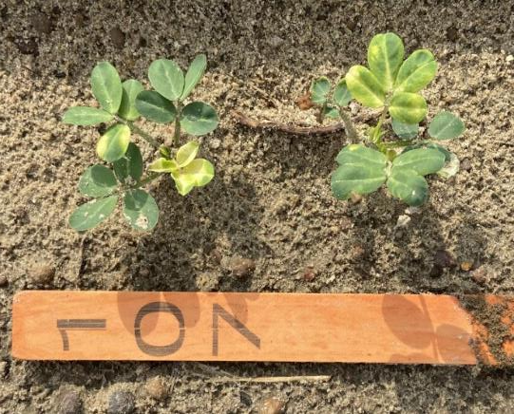
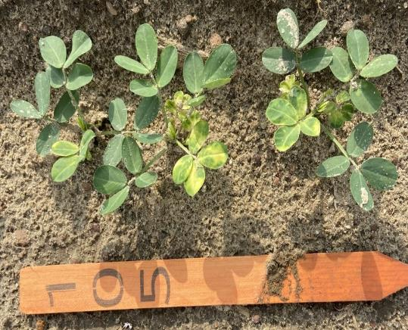
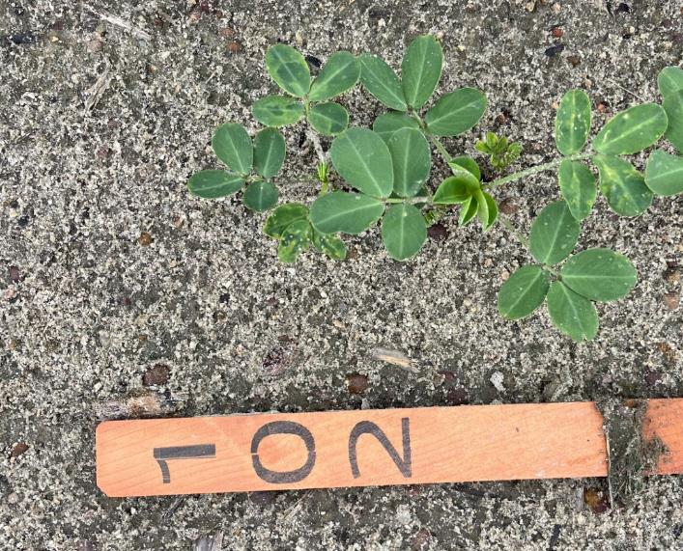
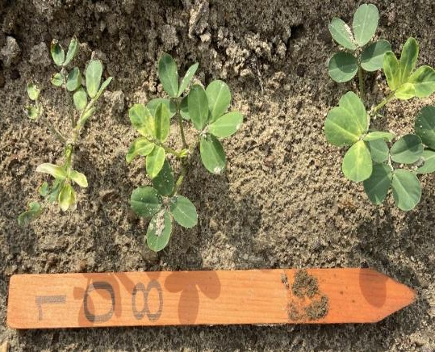
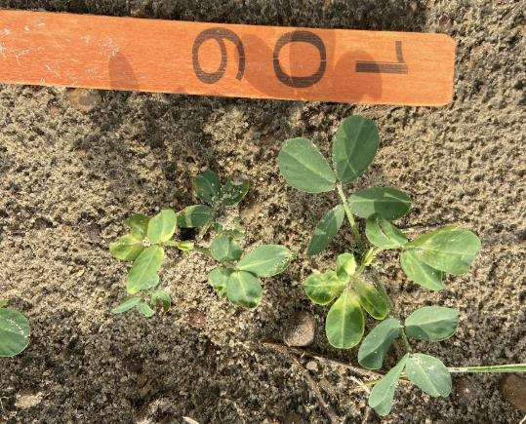
  Results:
  Fluridone
5 DAP
1 DAP
NTC
13 DAP; May 15, 2023
3 DAP
7 DAP
Notes:
As you can see these photos capture some of that observed stunting as well as herbicide symptomology.

Slide 16
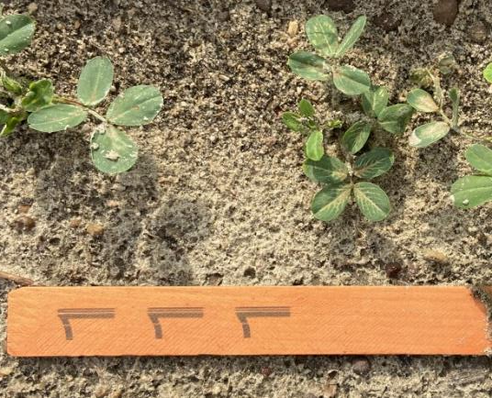
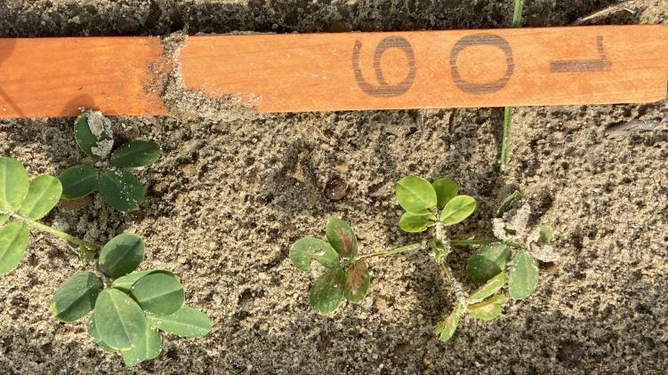
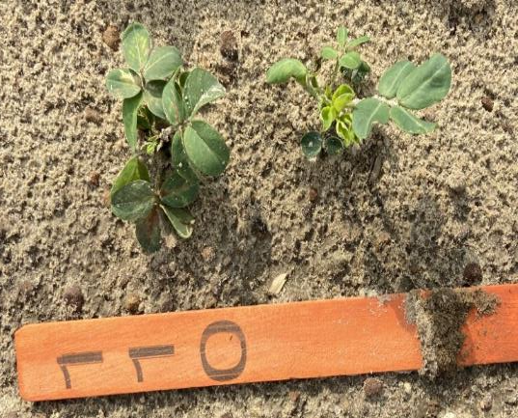
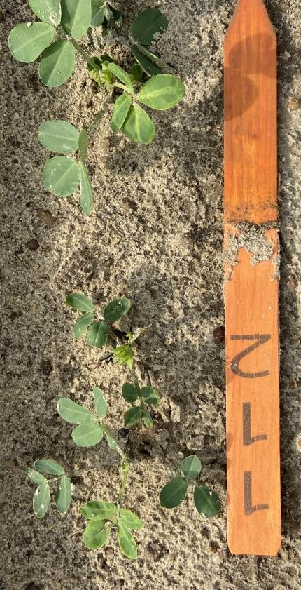
  Results:
  Trifludimoxazin
1 DAP
5 DAP
NTC
13 DAP; May 15, 2023
3 DAP
7 DAP

Slide 17
  Results:
  Peanut height 30 DAP following fluridone and trifludimoxazin (2022-2023)
P = 0.034
P = 0.03
*Columns with letter separation are significantly different at (P < 0.1)

Slide 18
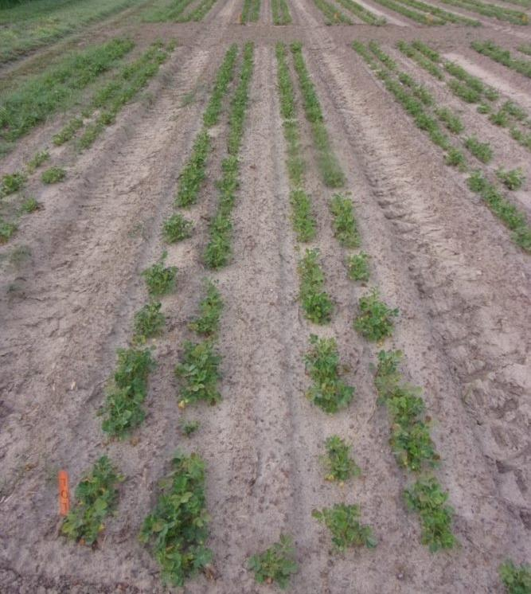
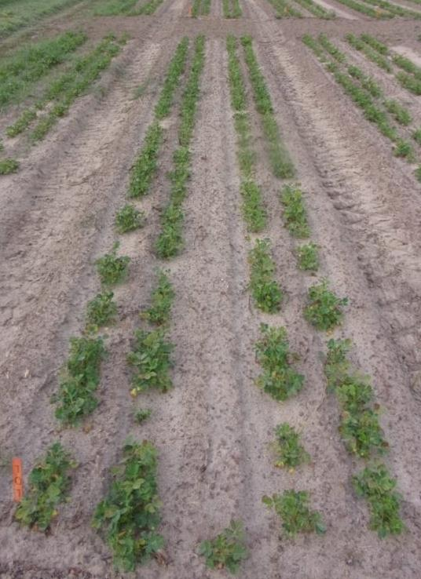
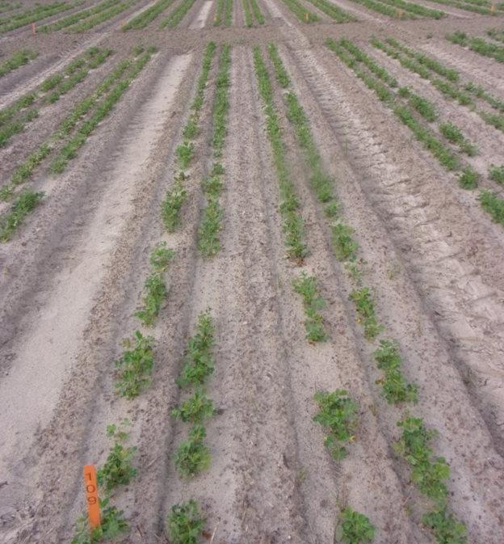
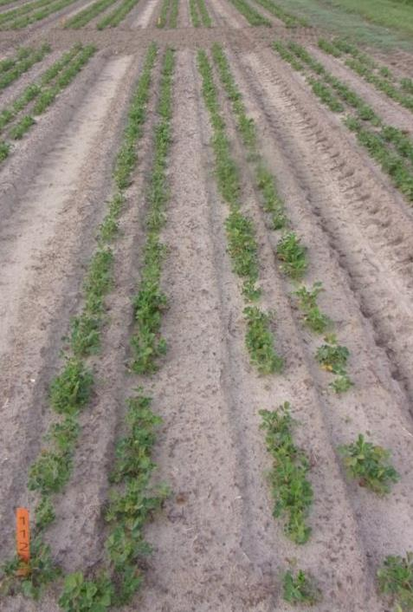
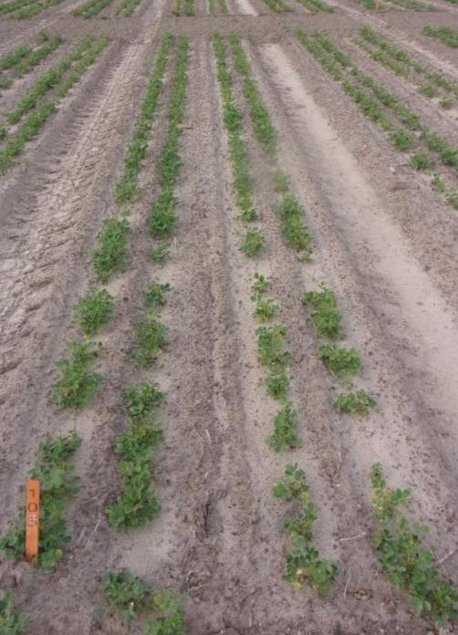
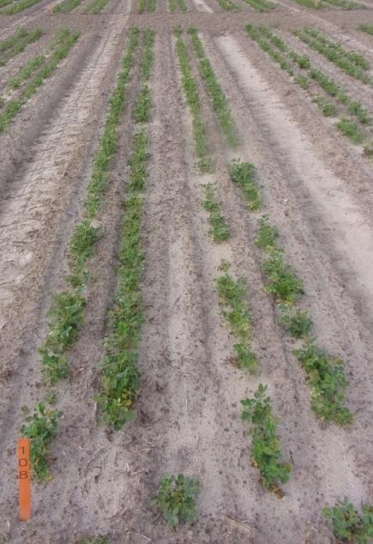
  Results:
  Fluridone
NTC
1 DAP
7 DAP
30 DAP; May 31, 2023

Slide 19
  Results:
  Trifludimoxazin
NTC
1 DAP
7 DAP
30 DAP; May 31, 2023

Slide 20
  Results:
  Peanut height 80 DAP following fluridone and trifludimoxazin (2022-2023)
P = 0.23
P = 0.034

Slide 21
  Results:
  Peanut yield following fluridone and trifludimoxazin (2022-2023)
P = 0.88
P = 0.034

Slide 22
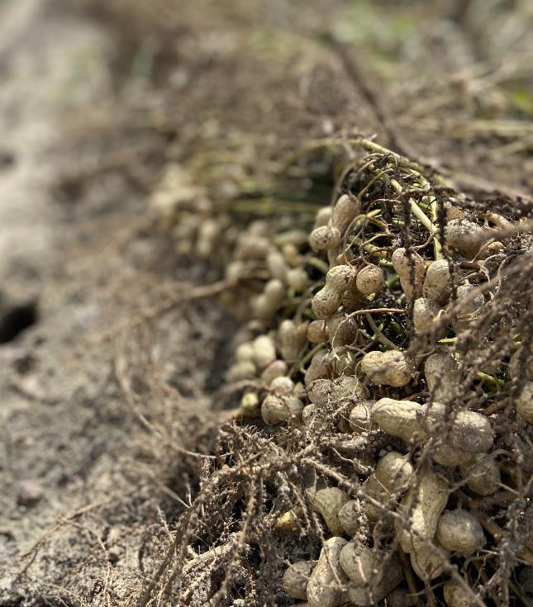
  Conclusions:
Density:
  Fluridone – slight decrease (6%)
  Trifludimoxazin – no effect
Increased visual injury with delayed applications
Plant height:
  30 DAP: Fluridone = no effect; Trifludimoxazin 6% reduction
  80 DAP: no effect regardless of herbicide or timing
No effect on yield
Overall Takeaway:
  Peanuts were tolerant to applications of fluridone and trifludimoxazin up to 7 DAP without negatively impacting yield.
Notes:
Ho discussion
Slight decrease – still above threshold

Slide 23
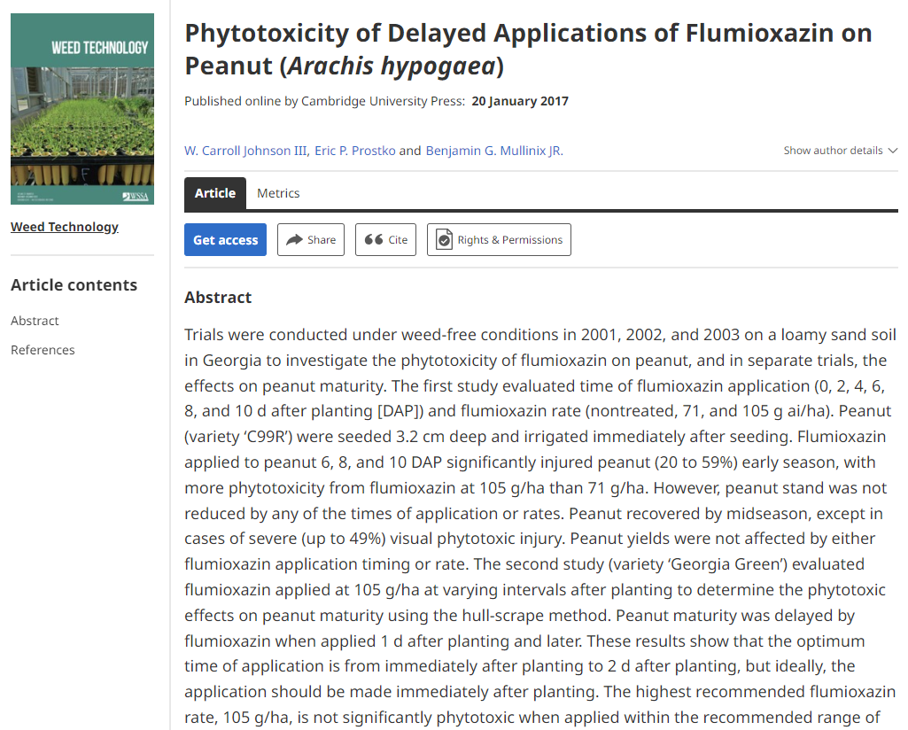
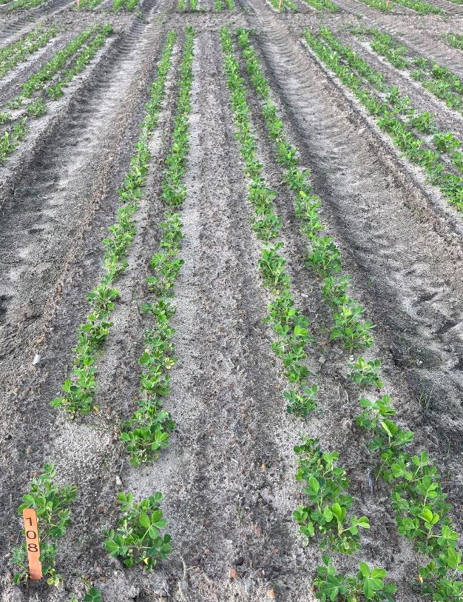
  Previous research Future work:
Supports previous research
2024

Slide 24
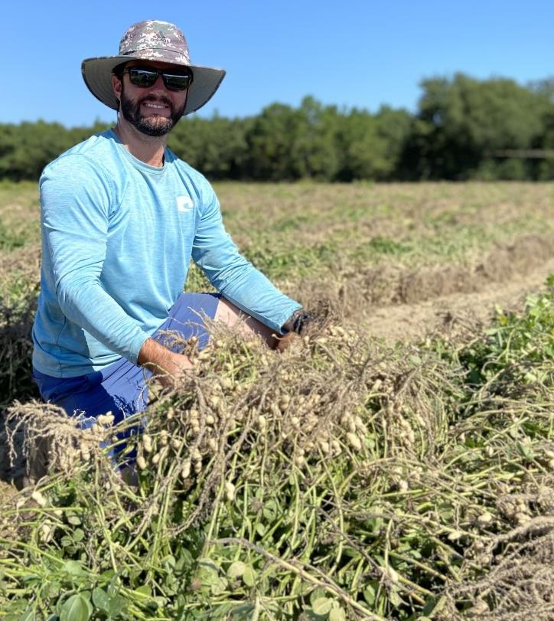



  Thank you
Crop & Soil Sciences
Acknowledgements
Dr. Eric Prostko
Dr. Chad Abbott
Charlie Hilton
Tim Richards
Dewayne Dales
nicholas.shay@uga.edu
Notes:
If interested in slide set – gaweed.com

